Slide 1

Eff {Strings} Last.fm Music Data Study
Amber
Christian
Ishmael
Steve

Slide 2
Background
Last.fm is a global application that builds a profile of users’ musical taste based on the
songs a user listens to on internet radio, their PC, or other portable music devices.
They pay unsigned artists royalties to stream their music.
Last.fm CEO has tasked music supervisors with recommending and selecting appropriate
music and licenses to provide on their app.
Music Supervisors are analyzing global music data against Gross National Product (GNP)
To determine whether economic indicators affect listeners and play counts. This
information will inform the most profitable music selections globally, providing guidance
to inform Music Supervisors’ selection criteria.

Slide 3
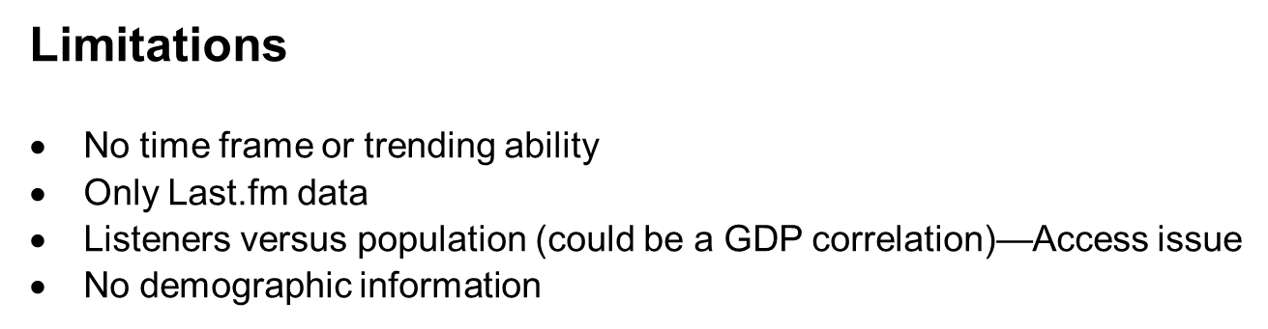
Hypothesis
If GDP is lower, Last.fm will have a higher listenership.

Slide 5
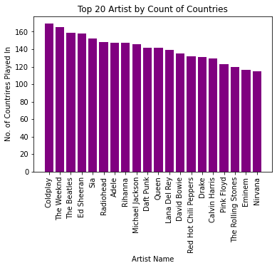
Which artist are most popular based on their country play count? Steve
Data demonstrates that:
Coldplay
The Weekend
The Beatles
Ed Sheeran
Sia
Radiohead
Adele
Data shows how often artists are listened to regardless of listener (or user)
Music quote here

Slide 6
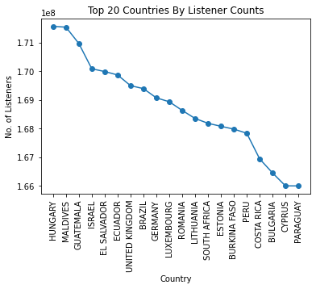
Which countries’ users engage the most with the app? Steve
Hungary has the most users engaged with the app, followed closely with Maldives.
Followed by
Guatemala
Israel
El Salvador
Ecuador
United Kingdom
Music quote here

Slide 7

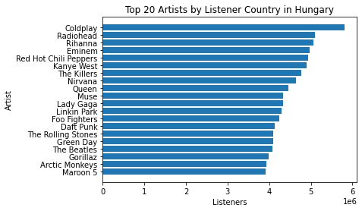
Who are the top artists by listener count in the country with the highest overall listener count (Hungary)?
Amber
The top artists listened to in Hungary, which has
the highest listener (or user) count, are:
This sets a standard for other countries.
Music quote here

Slide 8
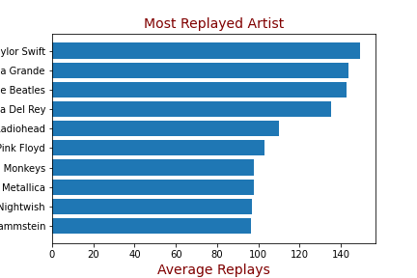
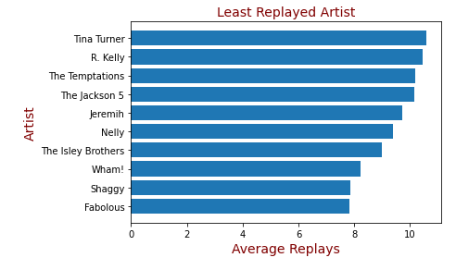
Who are the most
Music quote here

Slide 9
Which 5 artists are played most often globally?
Top 5 artists that are played the most globally are
This demonstrates the universal popularity of any
given artist, from which one can extract genre:
Music quote here

Slide 10
What are the most popular genres by listener per country? Christian Geomap
This aggregates up to the type of artist a music supervisor
should consider to select to include in the app
“Wake me up when this semester ends” – Green Day

Slide 11
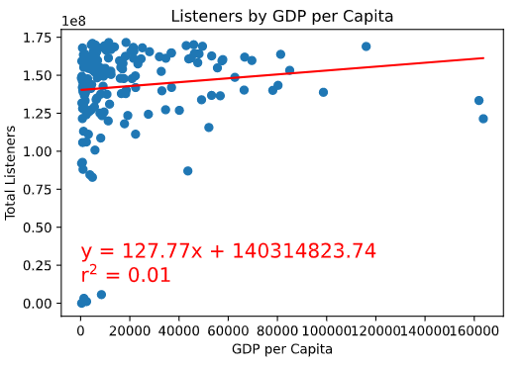
What is the GDP and play count of each country? Steve/Christian Statistical analysis
I think this should go first, as it would give context to the rest of the data given our hypothesis.
How should we explain the caveat of listener vs playcount?
Music quote here

